Slide 1
Celebration Key – Job Opportunities

Slide 2
300+ Direct Jobs
Finance
Management
Human Resources
Maintenance
Landscaping
IT
Security
Guest Services
And many more…

Slide 3
What are we looking for?
Guest focused
Positive thinking
Work ethic
Communicative & Flexible
Resilient & Virtuous
Responsible & Accountable

Slide 4
Timeline
Now
Q1-Q3 2024
Q1 2025
Q4 2024
Q2 2025
Job Fairs Begin
Recruitment for:
Supervisors
Line staff
Recruitment for:
General Manager
Site Engineer
HR Manager
Financial Controller
Director, Government and Community Engagements
Recruitment for:
Lifeguard Manager
Water Safety Manager
Housekeeping Manager
Guest Experience Manager
And many more!!

Slide 5
How to apply
halpcl.bamboohr.com/careers
ARE
WE
HIRING!

Slide 6
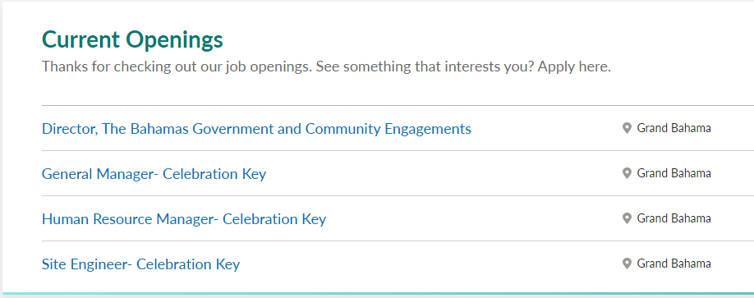
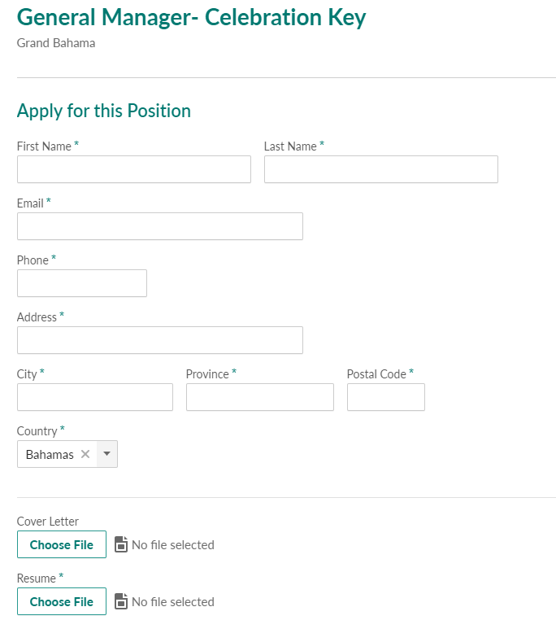
halpcl.bamboohr.com/careers
1
3
2

Slide 7
400+ Indirect Jobs
Retail Jobs
Will be Hired by 3rd Party Partners
More Details on How to Apply to Come in 2024
F&B Jobs

Slide 8
Thank You!

